Slide 1

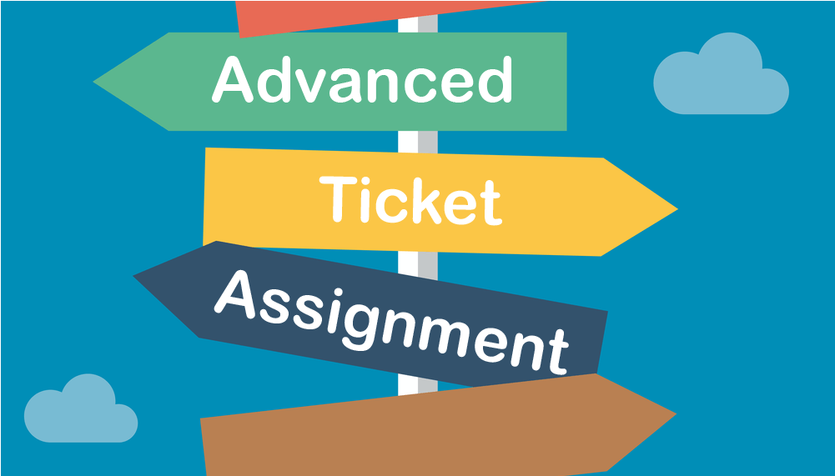
CAPSTONE PROJECT
AUTOMATIC TICKET CLASSIFICATION
Mentor
SURVESH CHAUHAN
AIML JuNE GROUP 4A
BRIJESH ARORA
GULAB S
SHIVAKUMAR RAMAN
SWAMINATHAN KANNAN

Slide 2
Contents
Problem Statement
Business value
Milestones
    Pre-Processing, Data Visualization and EDA
    Model Building
    Test the Model, Fine-tuning and Repeat
Conclusion
Learning
Challenges
Interesting Thing Encountered
Further Steps

Slide 3
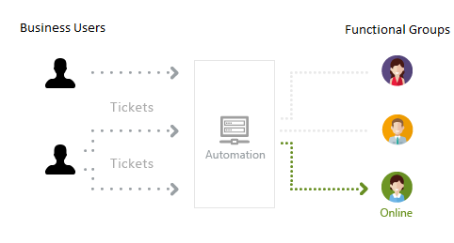
Problem Statement
The goal is to build a classifier using powerful AI/ML techniques that can classify the IT tickets to right functional groups for resolution.

Slide 4


Business Value
Reduced issue resolution TAT
Focus on more productive tasks

Slide 5
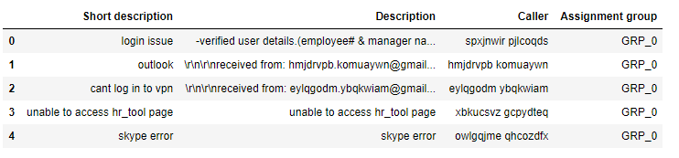
Milestone 1: Pre-Processing, Data Visualization and EDA
Data File Analysis
No of records – 8500
No of columns - 4
Column Details
    Short description (short description of the ticket)
    Description (A longer explanation of the ticket)
    Caller (The person who issued the ticket)
    Assignment group (The Group which finally answered the ticket)

Slide 6
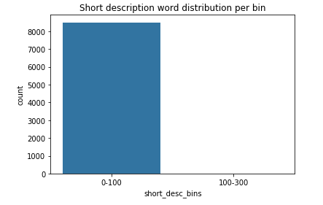
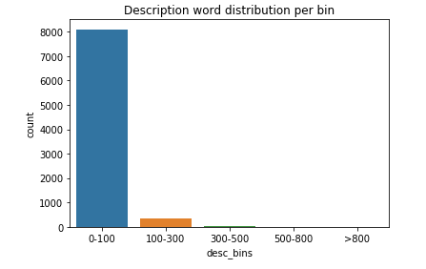
Milestone 1: Pre-Processing, Data Visualization and EDA
Word distribution in Short Description
Word distribution in Description
Each record has word count < 100
95% records have word count < 100
4% have it between 100 and 300
1% have it > 300

Slide 7
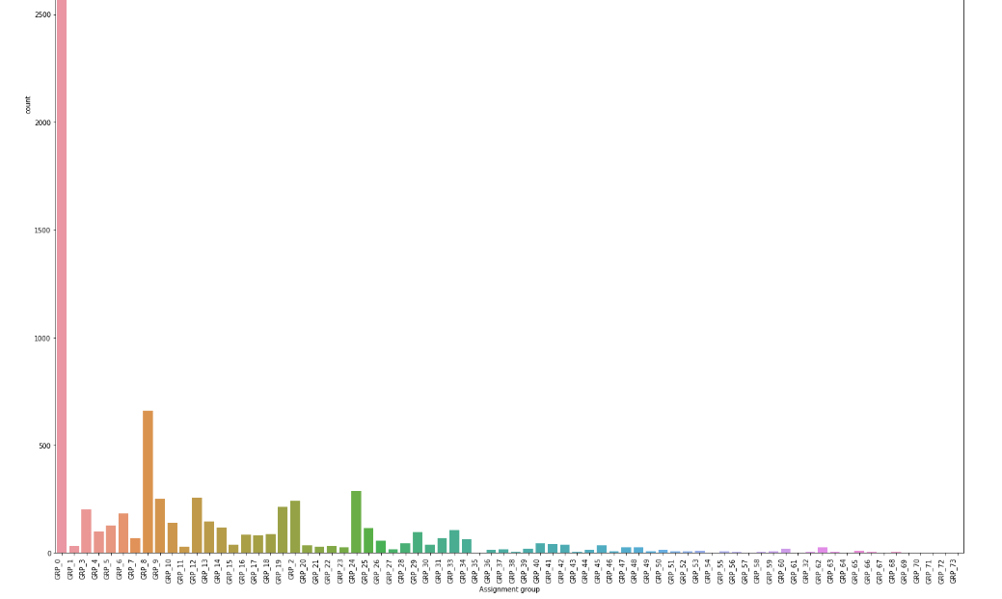
Milestone 1: Pre-Processing, Data Visualization and EDA
Understanding Target Column - Assignment Group
Key Observation
Group_0 has maximum tickets assigned around 47%

Slide 8
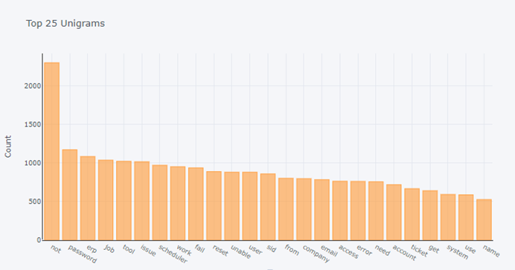
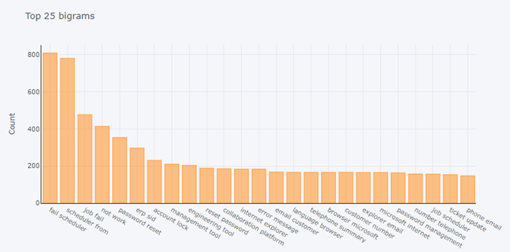
Milestone 1: Pre-Processing, Data Visualization and EDA
Understanding N-GRAMS

Slide 9
Milestone 1: Pre-Processing, Data Visualization and EDA
Steps Taken
Translation of non English language into English using Google Sheets
Concatenation of Short description and Description with duplicate handling
Merging of 39 groups into 1 as only 4% tickets assigned to these
All text was converted to lower case
Missing values were checked and handled
Numbers were removed
Punctuations, spaces, indents, etc were removed
Stop words were removed
E-mail id’s were removed
Caller name was removed
Lemmatization was done
Tokens created
Word vocabulary created, there are 10327 words in it
Word embedding was created using GLOVE and Word2Vec

Slide 10
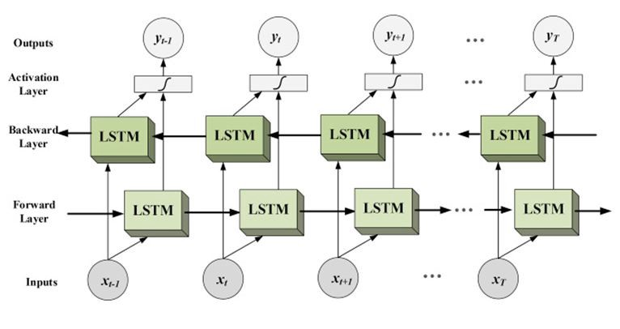
Milestone 2: Model Building
Model – Bidirectional LSTM
Reasons
  Preserve information from both past and future at any time
  Understand the context better
  Better performance on NLP sequence classification problem

Slide 11
Milestone 2: Model Building
Build the Model
  Parameters
    Embedding size = 200
    Maximum input length = 100
    Batch size = 100
    EPOCHS = 20
  Get The Word Embeddings Using GLOVE 200D File
  Create A Weight Matrix For Words in Vocabulary
  Create And Compile the Model
    Get Sequential Model Instance
    Add Embedding Layer
    Add Dropout Layer
    Add Bidirectional(LSTM) Layers
    Add Dropout Layer
    Add a Final Dense Layer with Softmax Activation

Slide 12
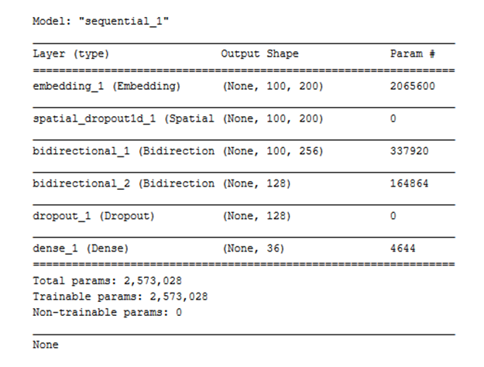
Milestone 2: Model Building
Model Summary

Slide 13
Milestone 2: Model Building
Split the Data
Data
80%
20%
Train
Test
80%
20%
Train
Validation

Slide 14
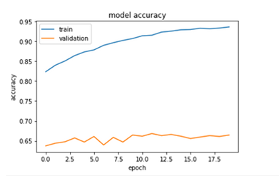
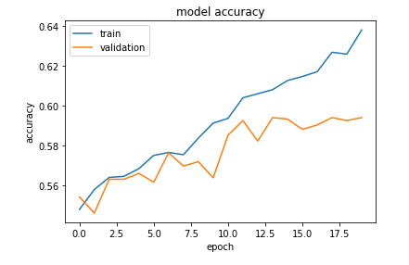
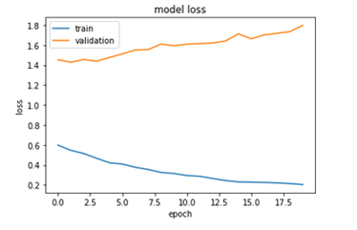
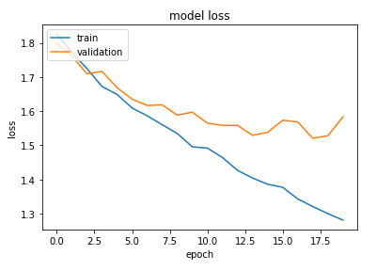
Milestone 2: Model Building
Model Training(GLOVE 200D)
Model Training(WORD2VEC Unigram)
Accuracy
Training – 94%
Validation – 66%
Accuracy
Training – 64%
Validation – 59%

Slide 15

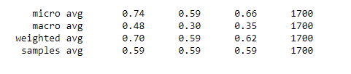
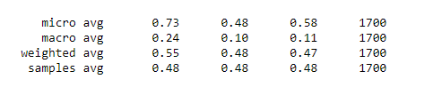
    Milestone 3: Test the Model, Fine-tuning and Repeat
EVALUATION ON TEST DATA
GLOVE 200D Embedding
Model Accuracy – 59%
Classification Report
WORD2VEC Unigram Embedding
Model Accuracy – 48%
Classification Report

Slide 16
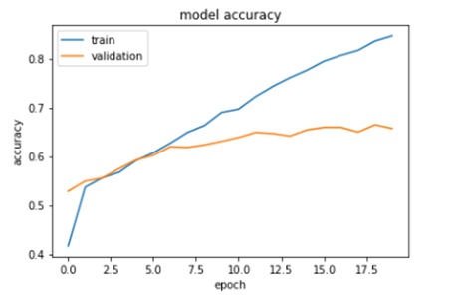
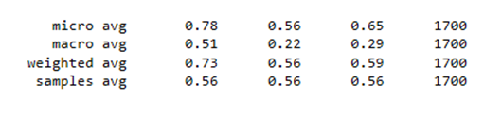
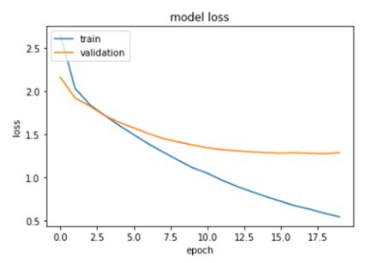
    Milestone 3: Test the Model, Fine-tuning and Repeat
Model Training(WORD2VEC 1000D)
Model Testing
Incorporating Bigrams and Trigrams
Model Accuracy – 56%
Classification Report
Accuracy
Training – 84.6%
Validation – 66%

Slide 17
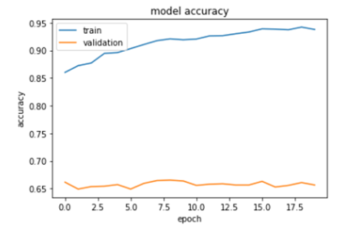

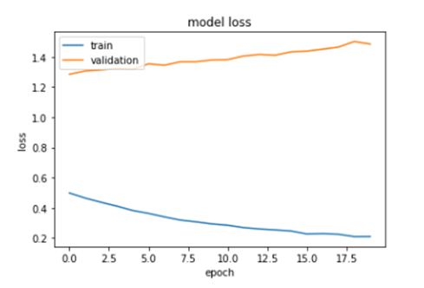
    Milestone 3: Test the Model, Fine-tuning and Repeat
Model Training(Balancing the Groups)
Model Testing
Word2Vec 1000D
Incorporating Bigrams and Trigrams
Model Accuracy – 58.41%
Classification Report
Accuracy
Training – 94%
Validation – 66%
Improvement seen in measures like overall accuracy, F1 Macro and weighted average

Slide 18
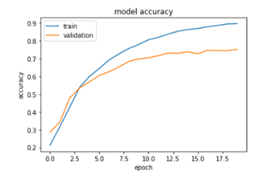
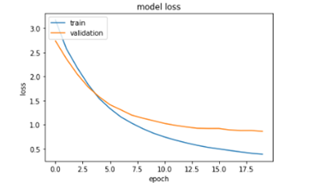

    Milestone 3: Test the Model, Fine-tuning and Repeat
Model Training(Up Sampling & Down Sampling)
Model Testing
Word2Vec 1000D
Incorporating Bigrams and Trigrams
Re-sampled Groups
Model Accuracy – 68%
Classification Report
Accuracy
Training – 86%
Validation – 75%
Good improvement seen in all measures

Slide 19
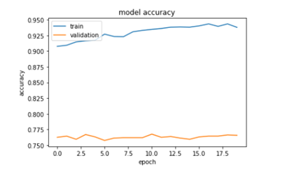
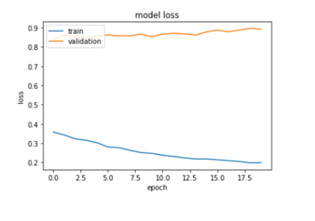

    Milestone 3: Test the Model, Fine-tuning and Repeat
Model Training(Applying Class Weigt)
Model Testing
Word2Vec 1000D
Incorporating Bigrams and Trigrams
Re-sampled Groups
Model Accuracy – 71%
Classification Report
Accuracy
Training – 94%
Validation – 76.5%
Again improvement seen in all measures

Slide 20
    Milestone 3: Test the Model, Fine-tuning and Repeat
FINE TUNING
  Adding Attention Layer
  Adding additional layer of Bidirectional LSTM
  Changing the drop-out rate
  Optimizing Adam
  Adding batch normalization

Slide 21
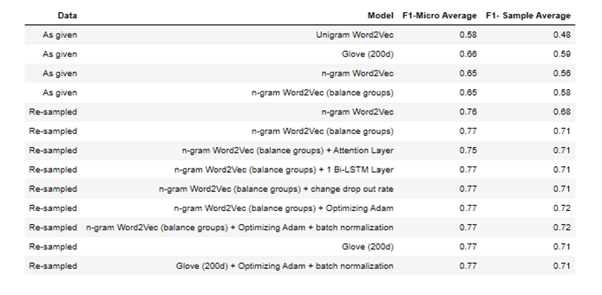
    Milestone 3: Test the Model, Fine-tuning and Repeat
ACCURACY SUMMARY OF DIFFERENT MODELS

Slide 22
    CONCLUSION
The Best Optimized Model
n-gram Word2Vec + Optimizing Adam.
Accuracy
  Training - 90.5%
  Validation - 76.8%
  Test - 71.85%
  F1-Score - 77%

Slide 23
    INTERESTING THING ENCOUNTERED
While testing the model with 100D, 200D and 300D Glove embedding
    Validation accuracy was found same for all
    Test accuracy was also found same for all

Slide 24
    FURTHER STEPS
Collect additional data on small groups to improve model prediction accuracy
Try advanced NLP models like Bert, Roberta, Elmo and improve model prediction accuracy

Slide 25
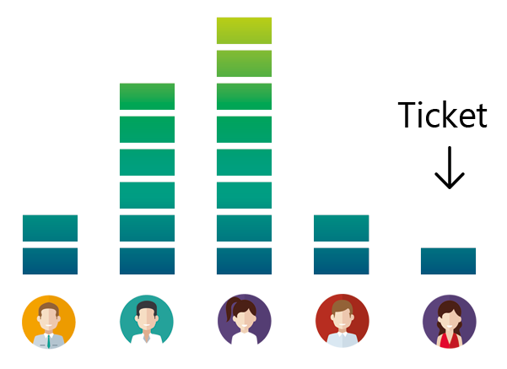
Thank You

